Slide 1
Git and Github
David C. Li
2023/03/09

Slide 2
Git
Git is a free and open source distributed version control system designed to handle everything from small to very large projects with speed and efficiency.
https://git-scm.com/

Slide 3
What is Git?
It is a version-control system (VCS) for tracking change in your coputer files (programs codes, datasets, files, logs….)
Distributed version control
Coordinate work between multiple developers
Help us to track who made, when change, what change
Revert back at any time
Local & remote repository

Slide 4
Important concepts of Git
Keep track of code history
Take “snapshots” of your files
You can decide when to take a snapshot by making a “commit”
You can visit any snapshots at any time
You can stage file before committing (stage means you temporary save your file in the workspaces before committing)

Slide 5
Download the Git
https://git-scm.com/download/win
https://git-scm.com/

Slide 6
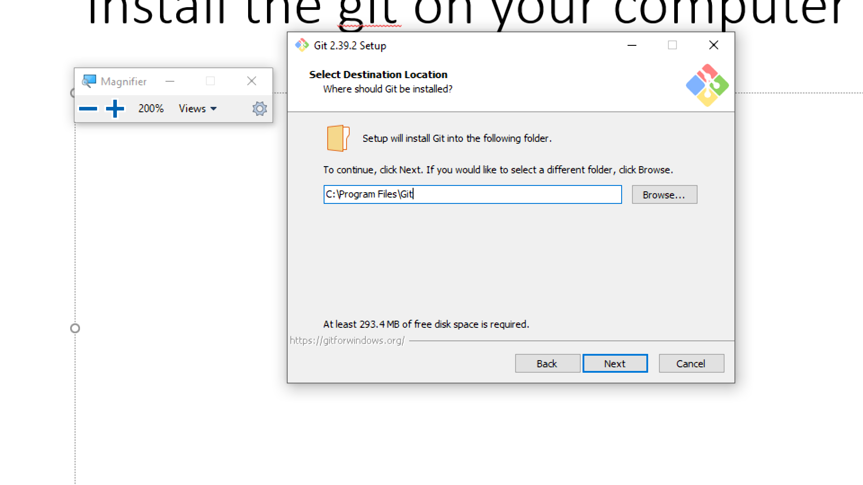
Install the git on your computer

Slide 7
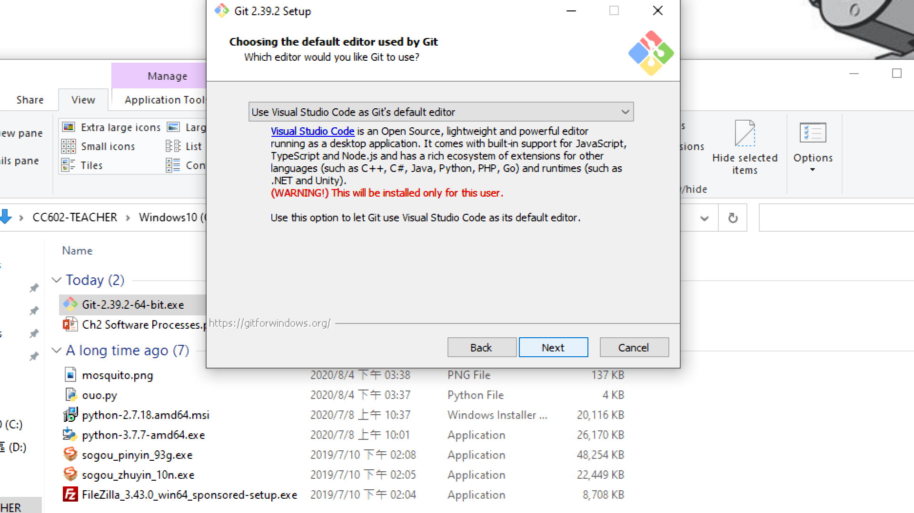

Slide 8
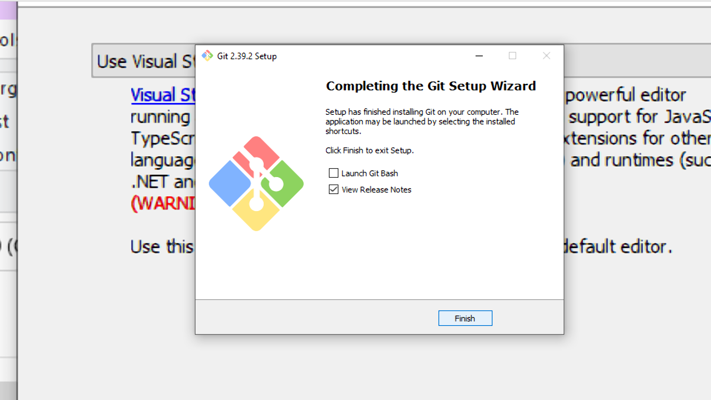

Slide 9
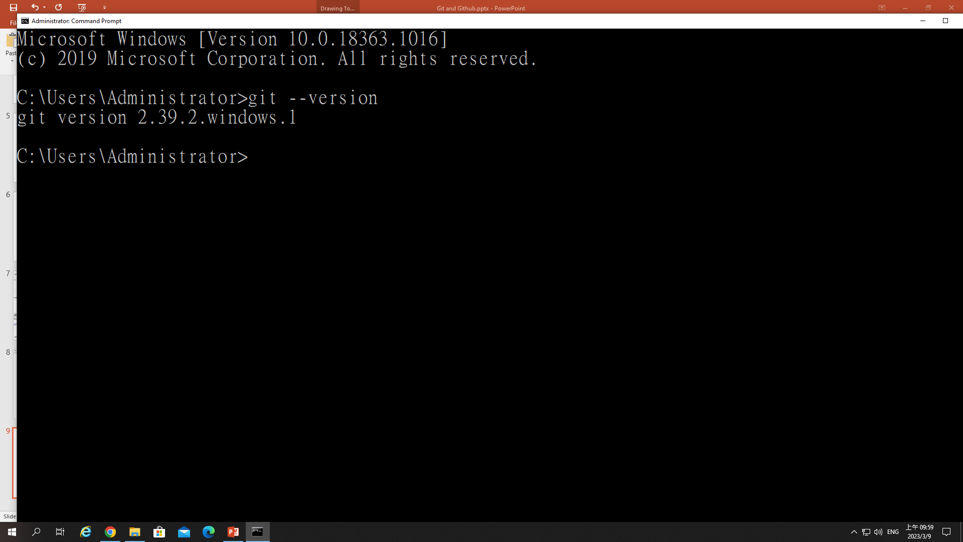

Slide 10
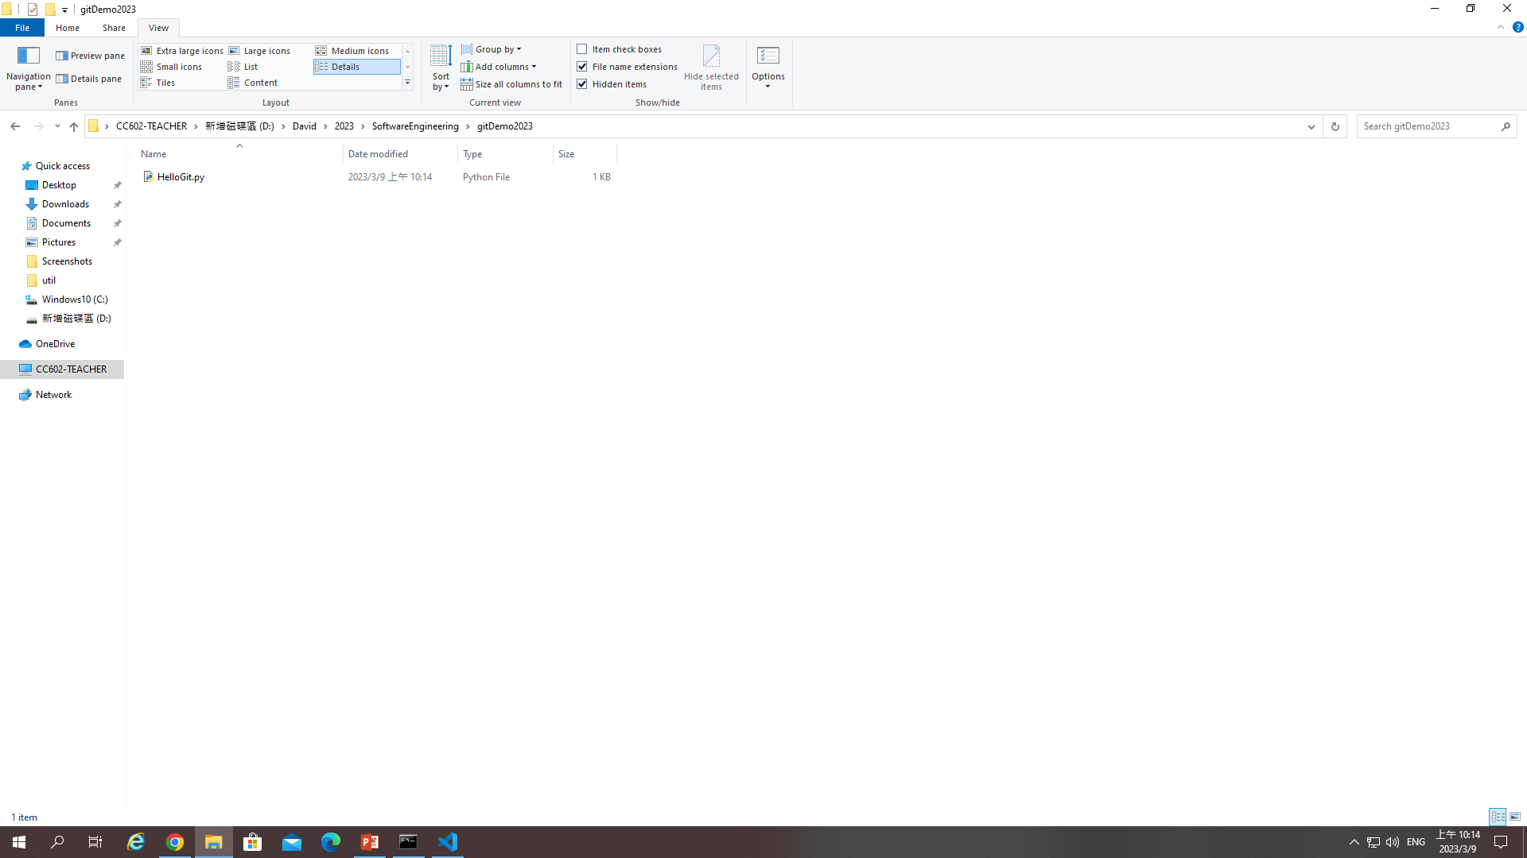
How to use the Git?
Step 1: initialize your project folder as a local repository, by typing command: git init

Slide 11
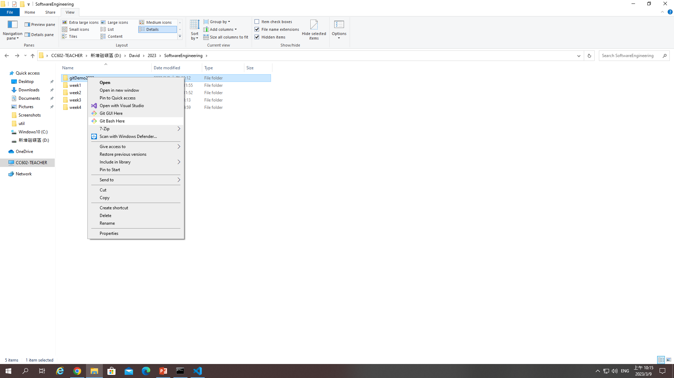

Slide 12
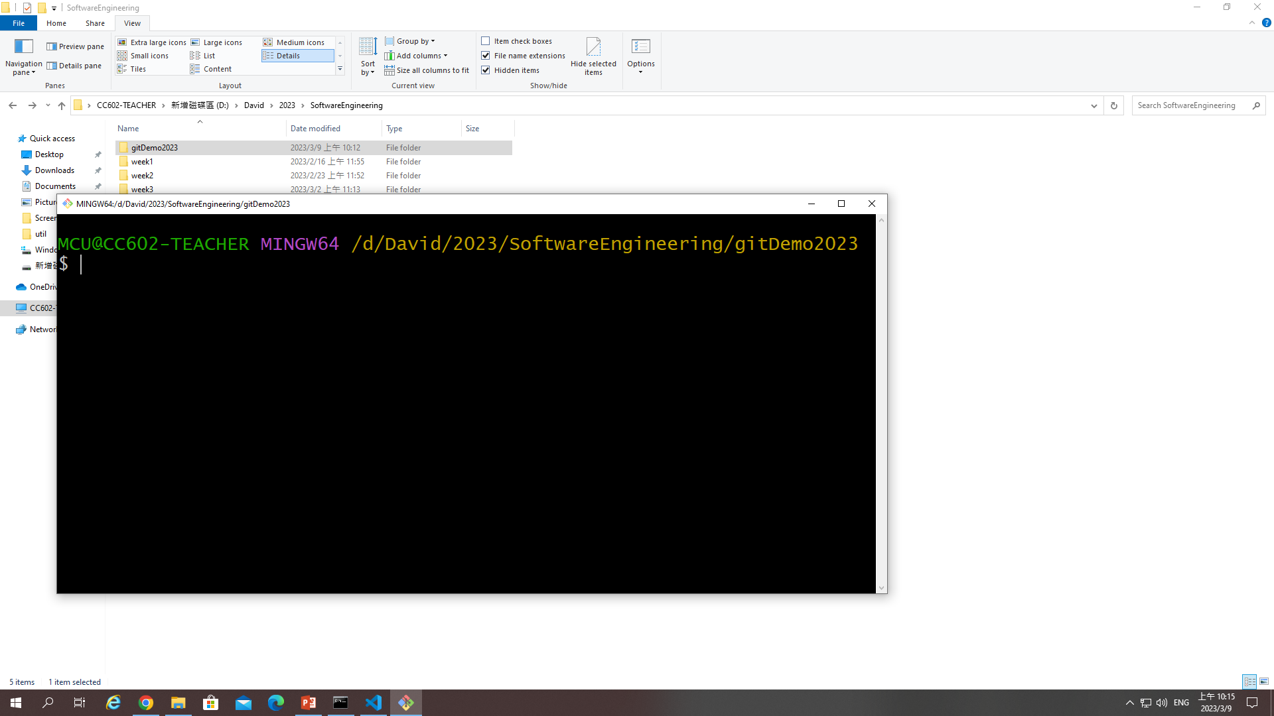

Slide 13
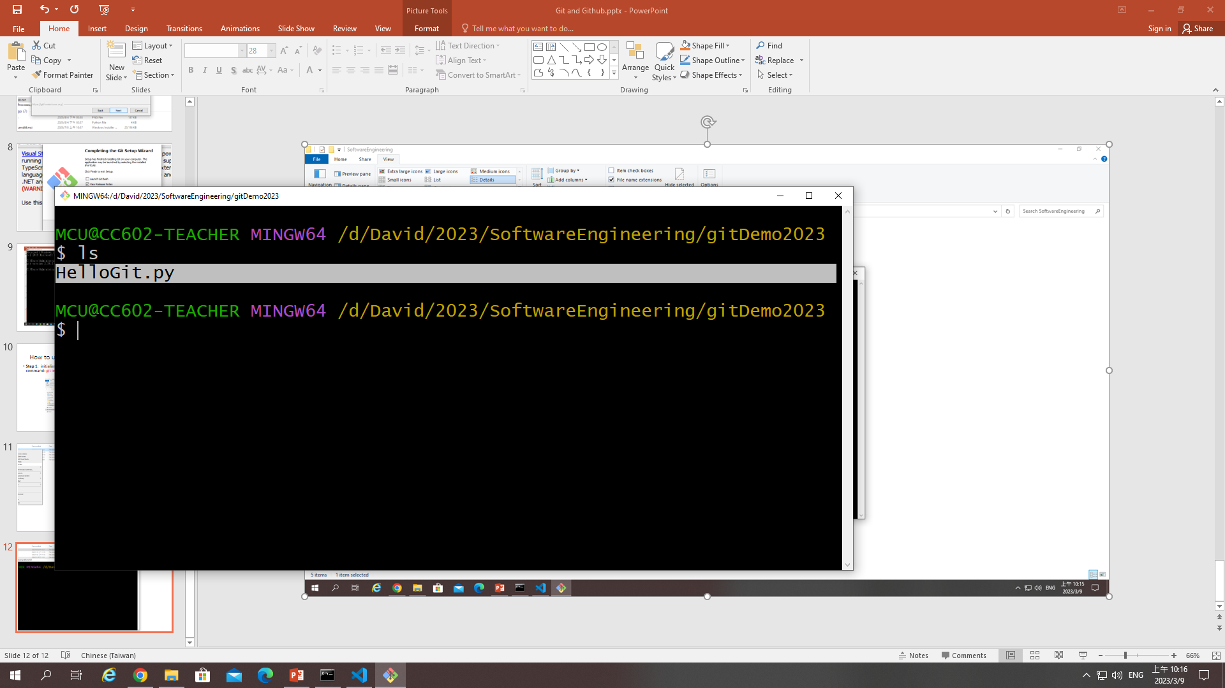

Slide 14
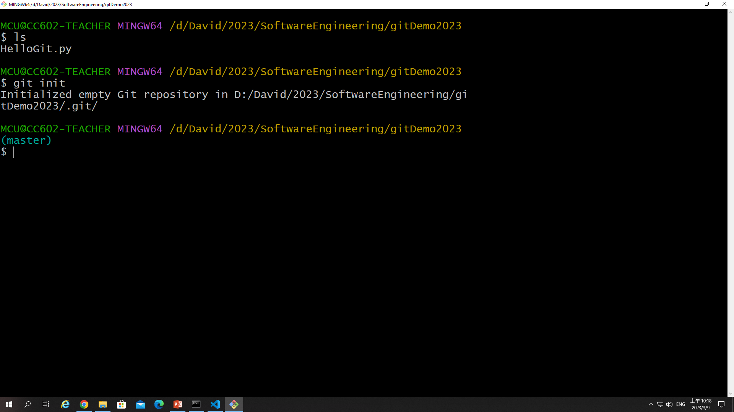
Initialized empty Git repository in D:/David/2023/SoftwareEngineering/gitDemo2023/.git/

Slide 15
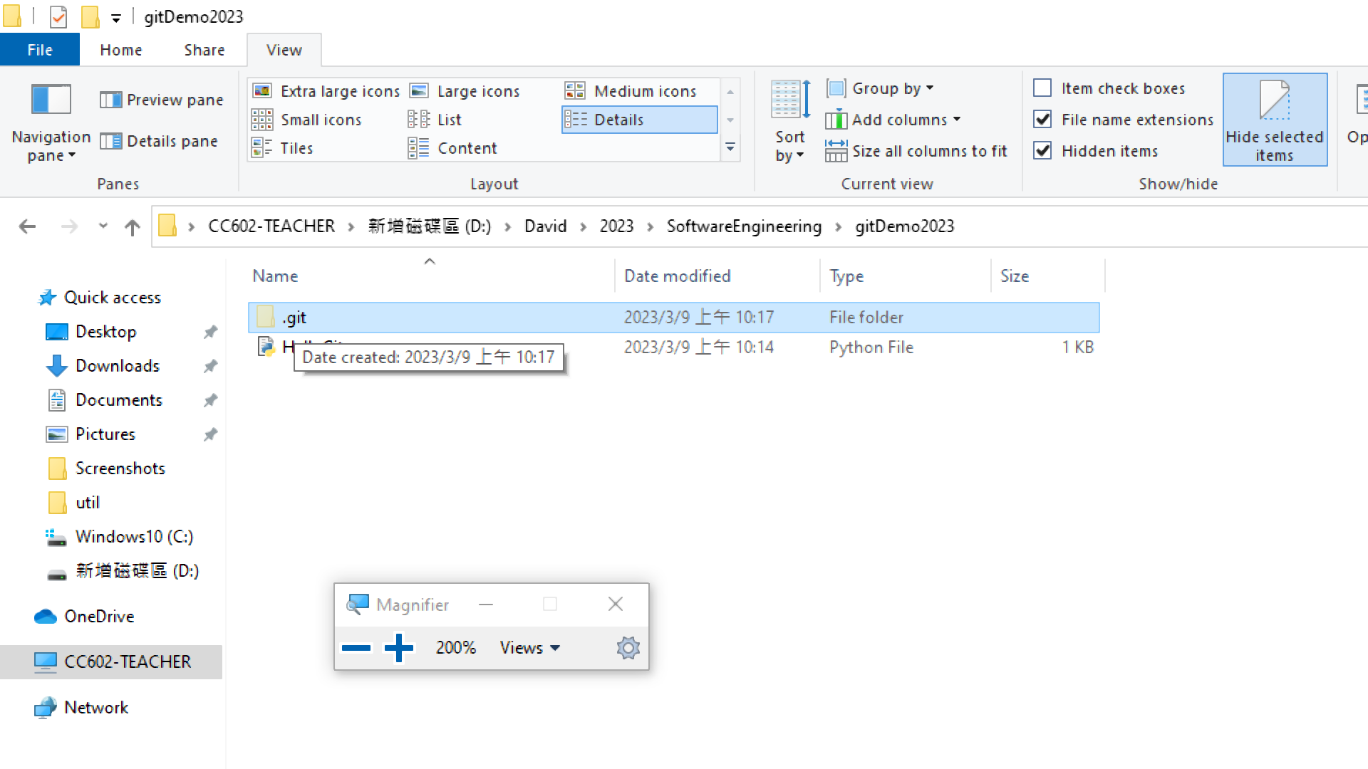

Slide 16
Configure your local repository
Step 2: we configure our local repository by using the command
git config --global user.name "David C. Li“
git config --global user.email "sunnydavidli@gmail.com"
In here, the email is the one you will sign in the GitHub

Slide 17
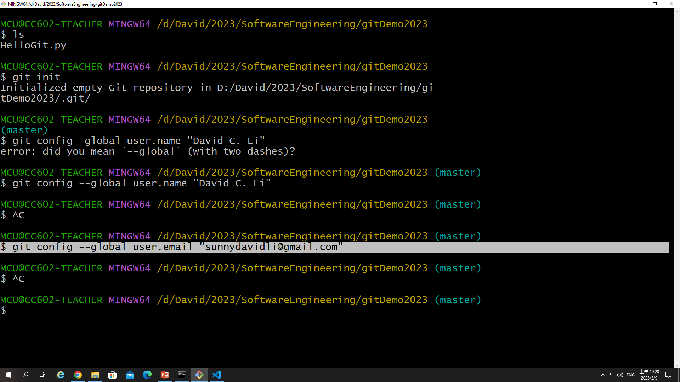

Slide 18
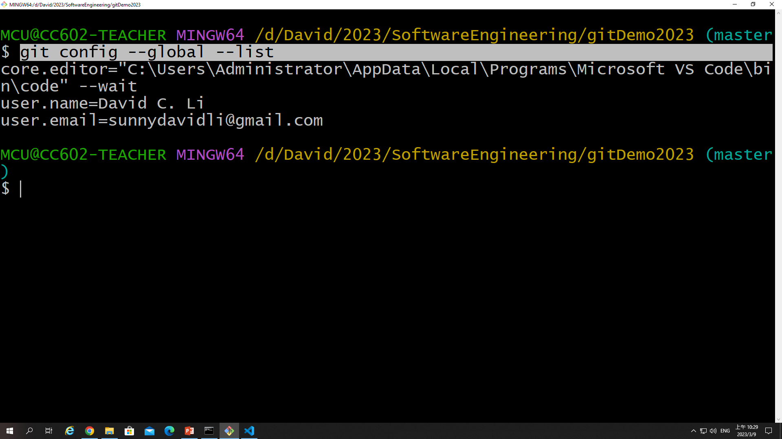
We check the configuration of Git on your local repository
Git

Slide 19
Concepts of Git work flow
Local repository is like your local project folder.
Local Repository
HelloGit.py
AnotherModule.py
DataAnalysis.py
Workspace
Local project folder (gitDemo2023):
Python files, text file, figures, logs…
AnotherModule.py
Stage (index)
Temporary save any new changed items
Commit
git add …
Hello.py

Slide 20
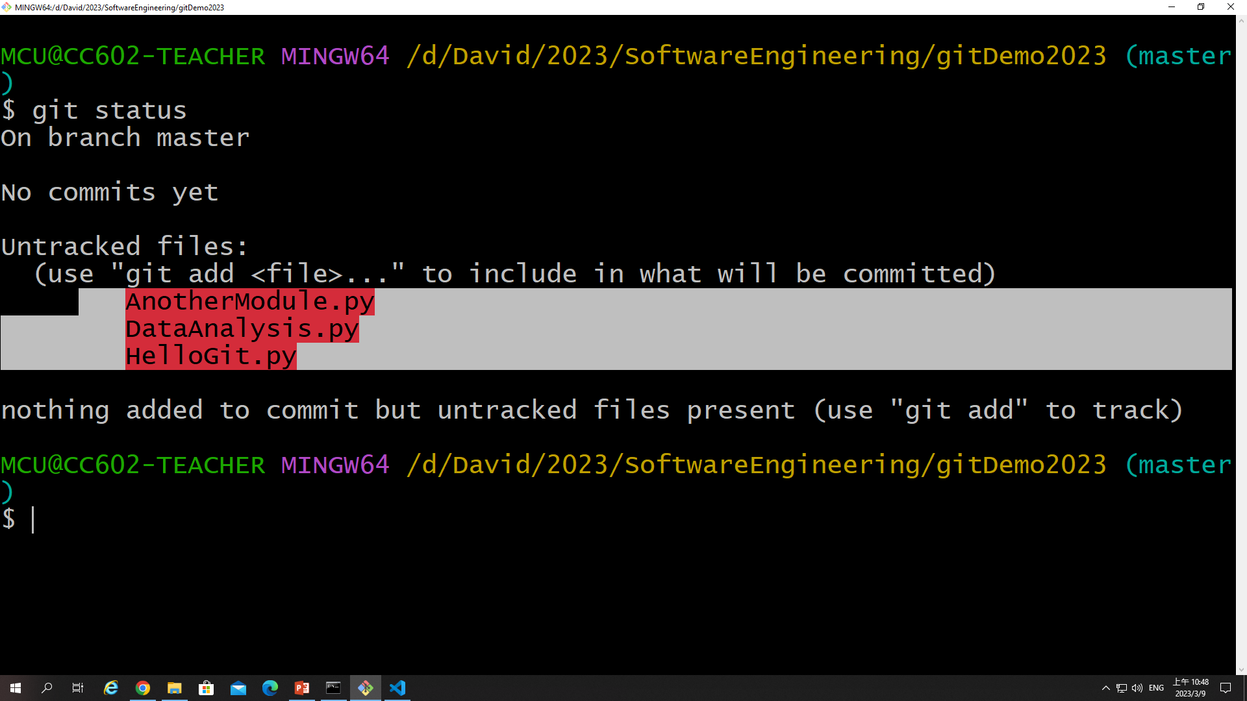
Git status to check your local repository current status

Slide 21
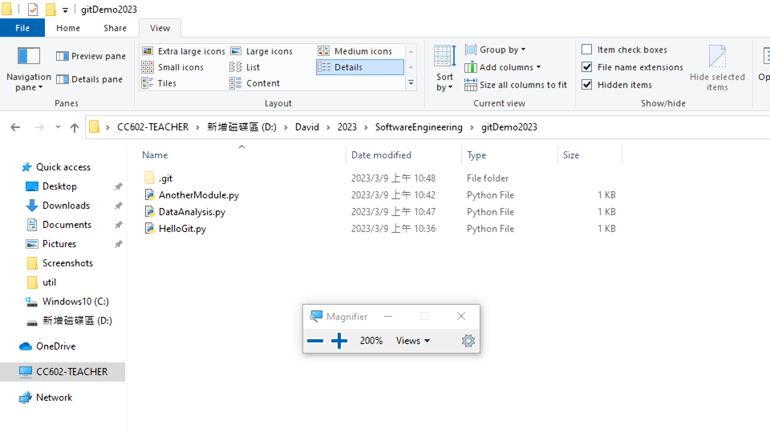

Slide 22
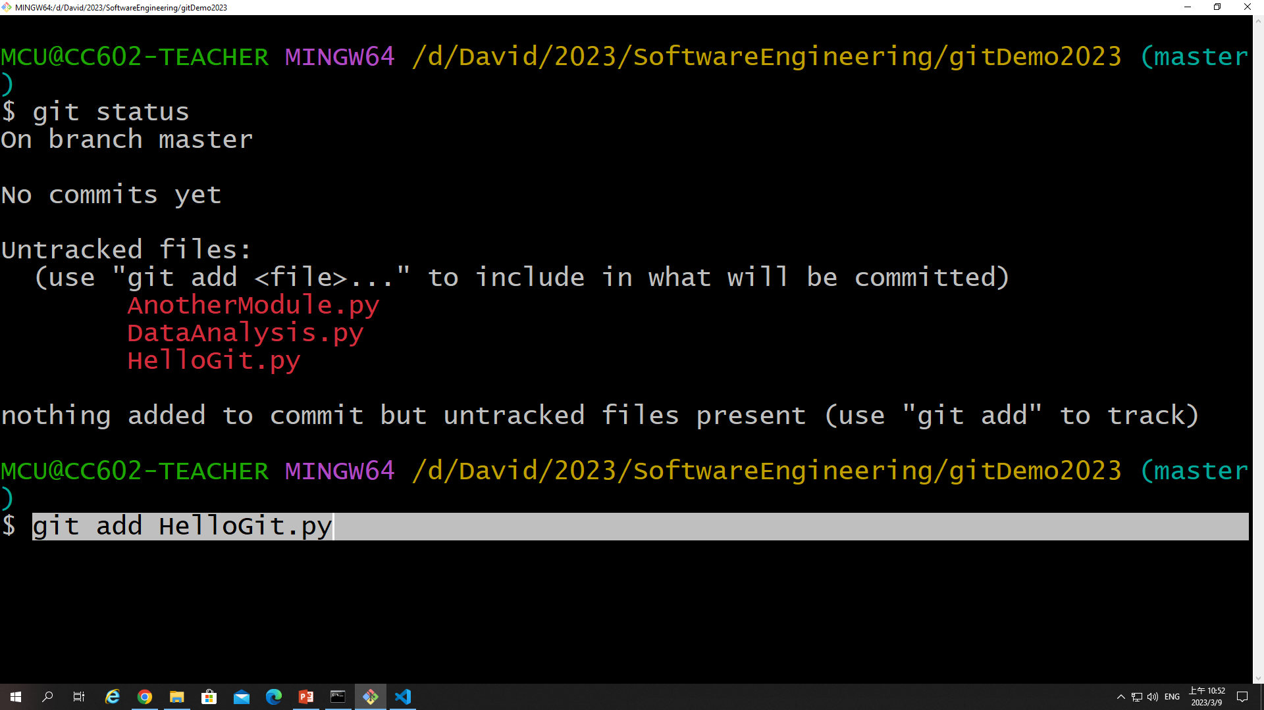
Git add HelloGit.py
We add the HelloGit.py to the stage area

Slide 23
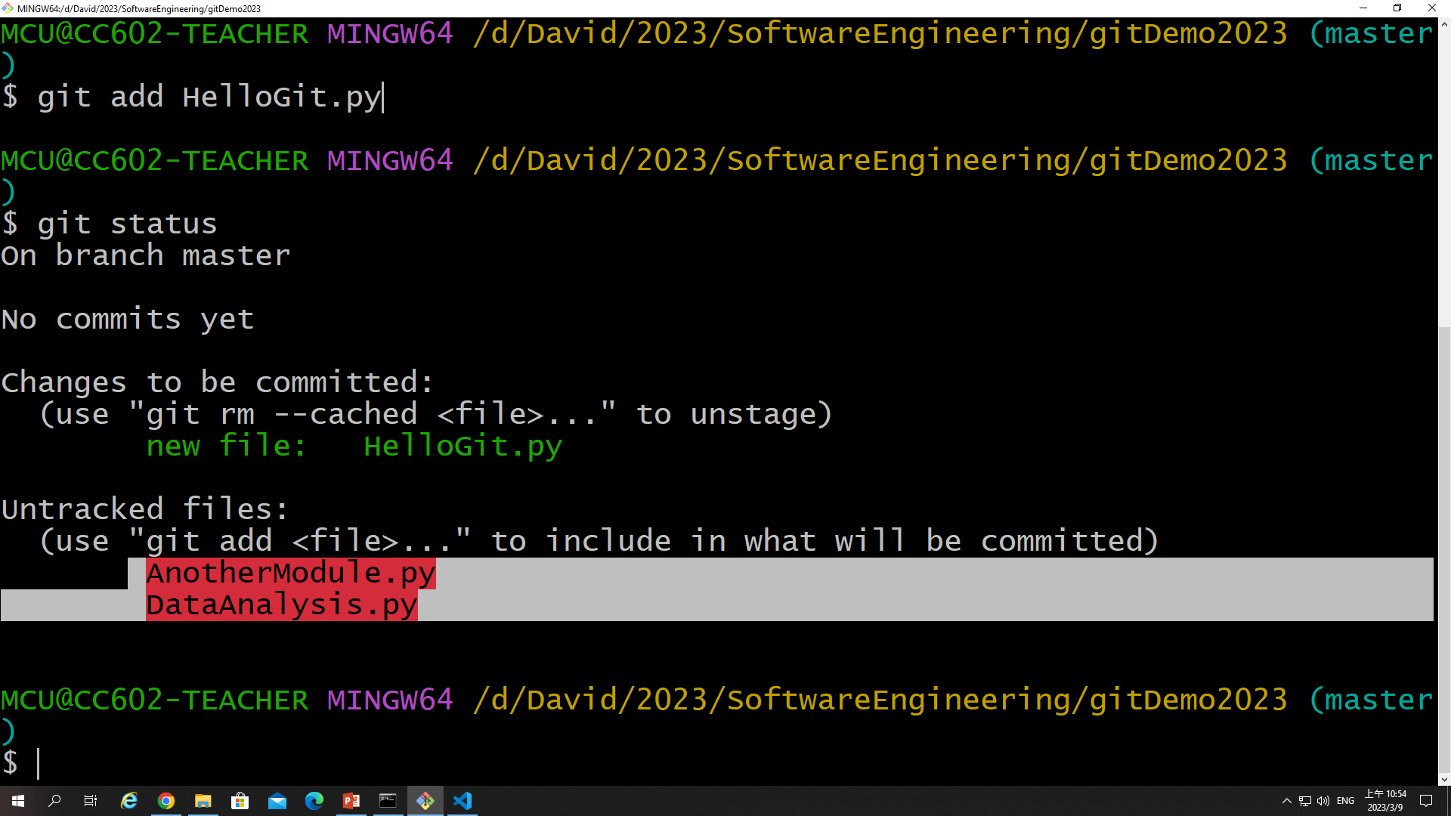

Slide 25
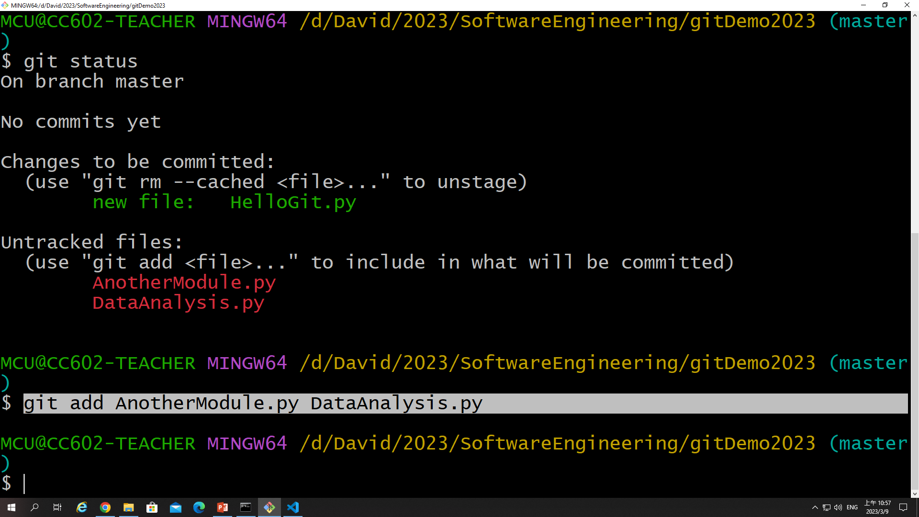
Git add onefile.py antherfile.py

Slide 26
Git add .
git add .: we will add all files in your current workspace to the stage area.

Slide 27
Git commit
We type git commit –m “message…” to commit any new changes are going to be control in local repository

Slide 28
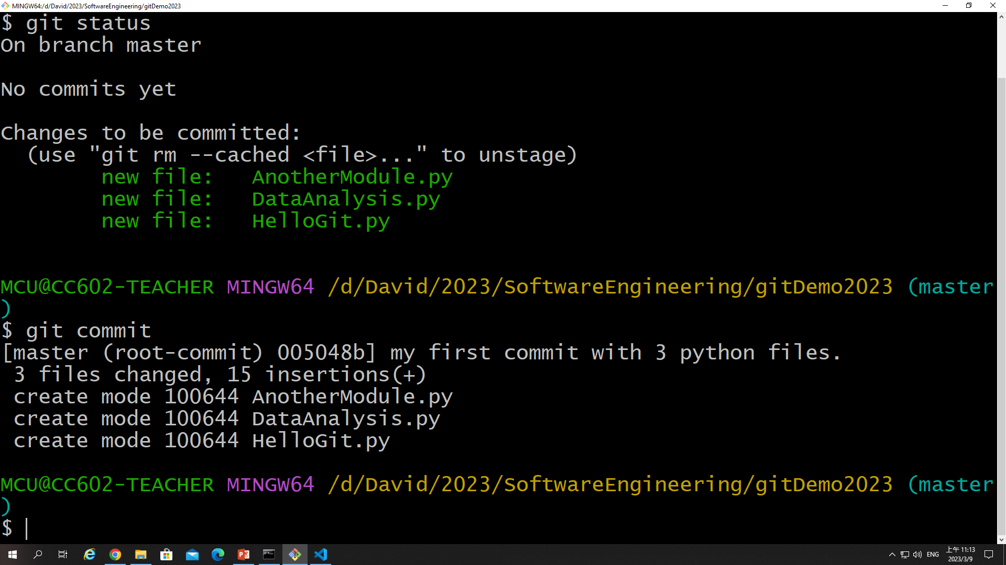

Slide 29
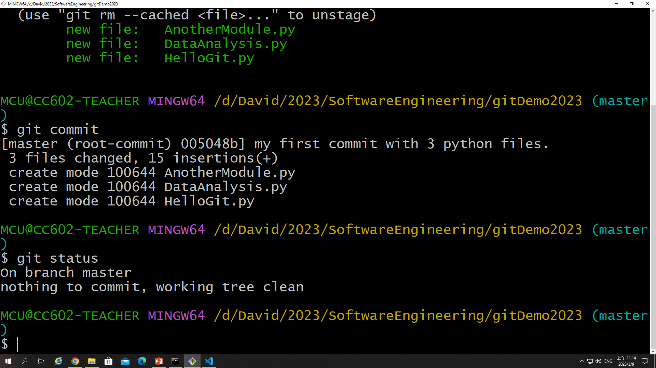

Slide 30
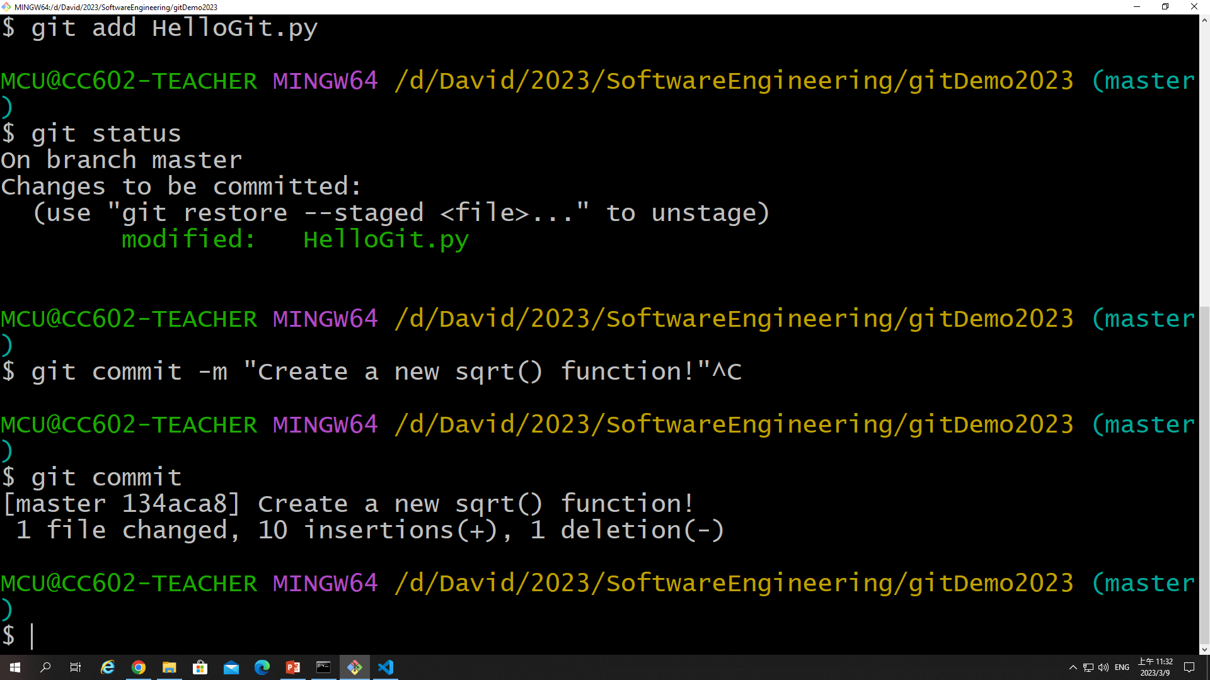

Slide 31
Github

Slide 32
Github
Sign up and sign in Github
Please create a remote repository on your github

Slide 33
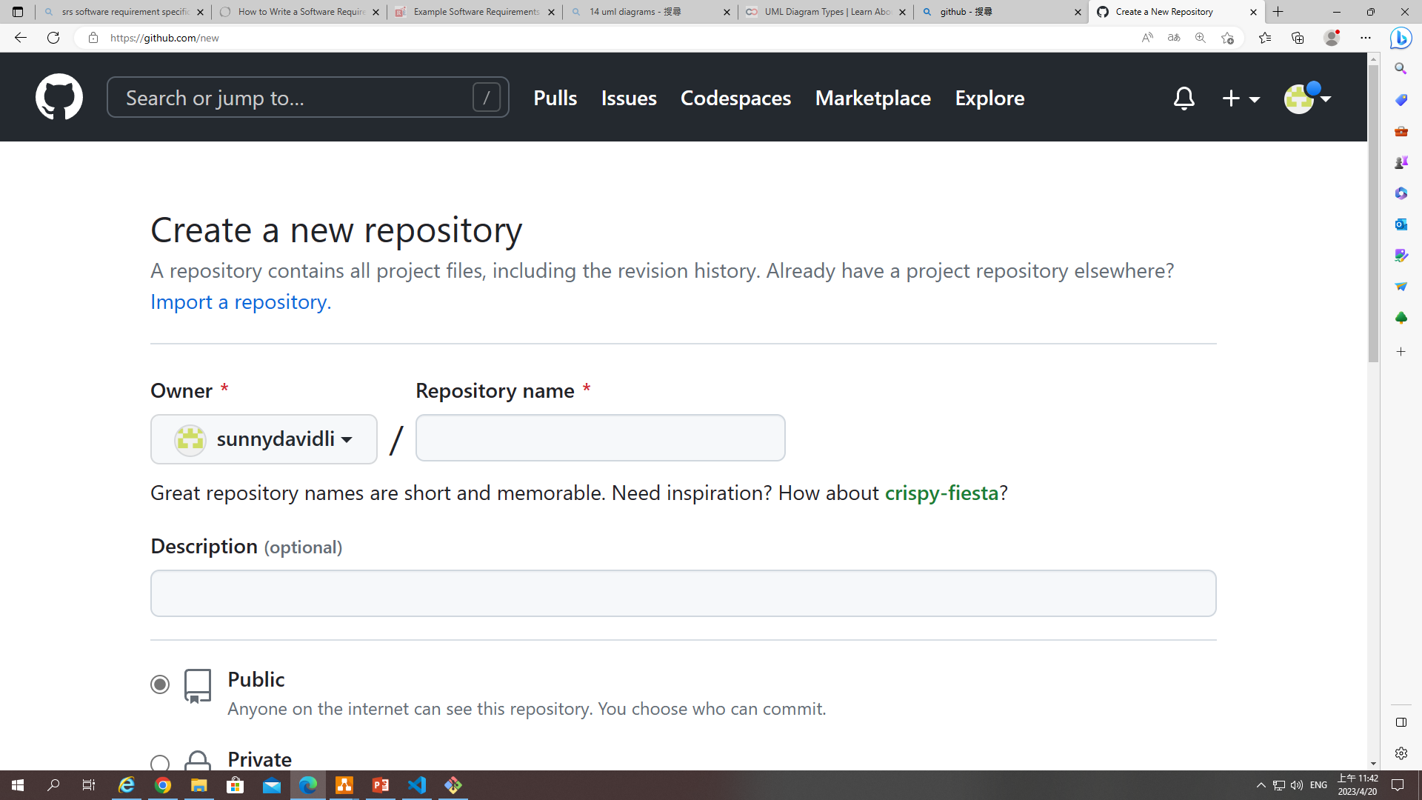

Slide 34
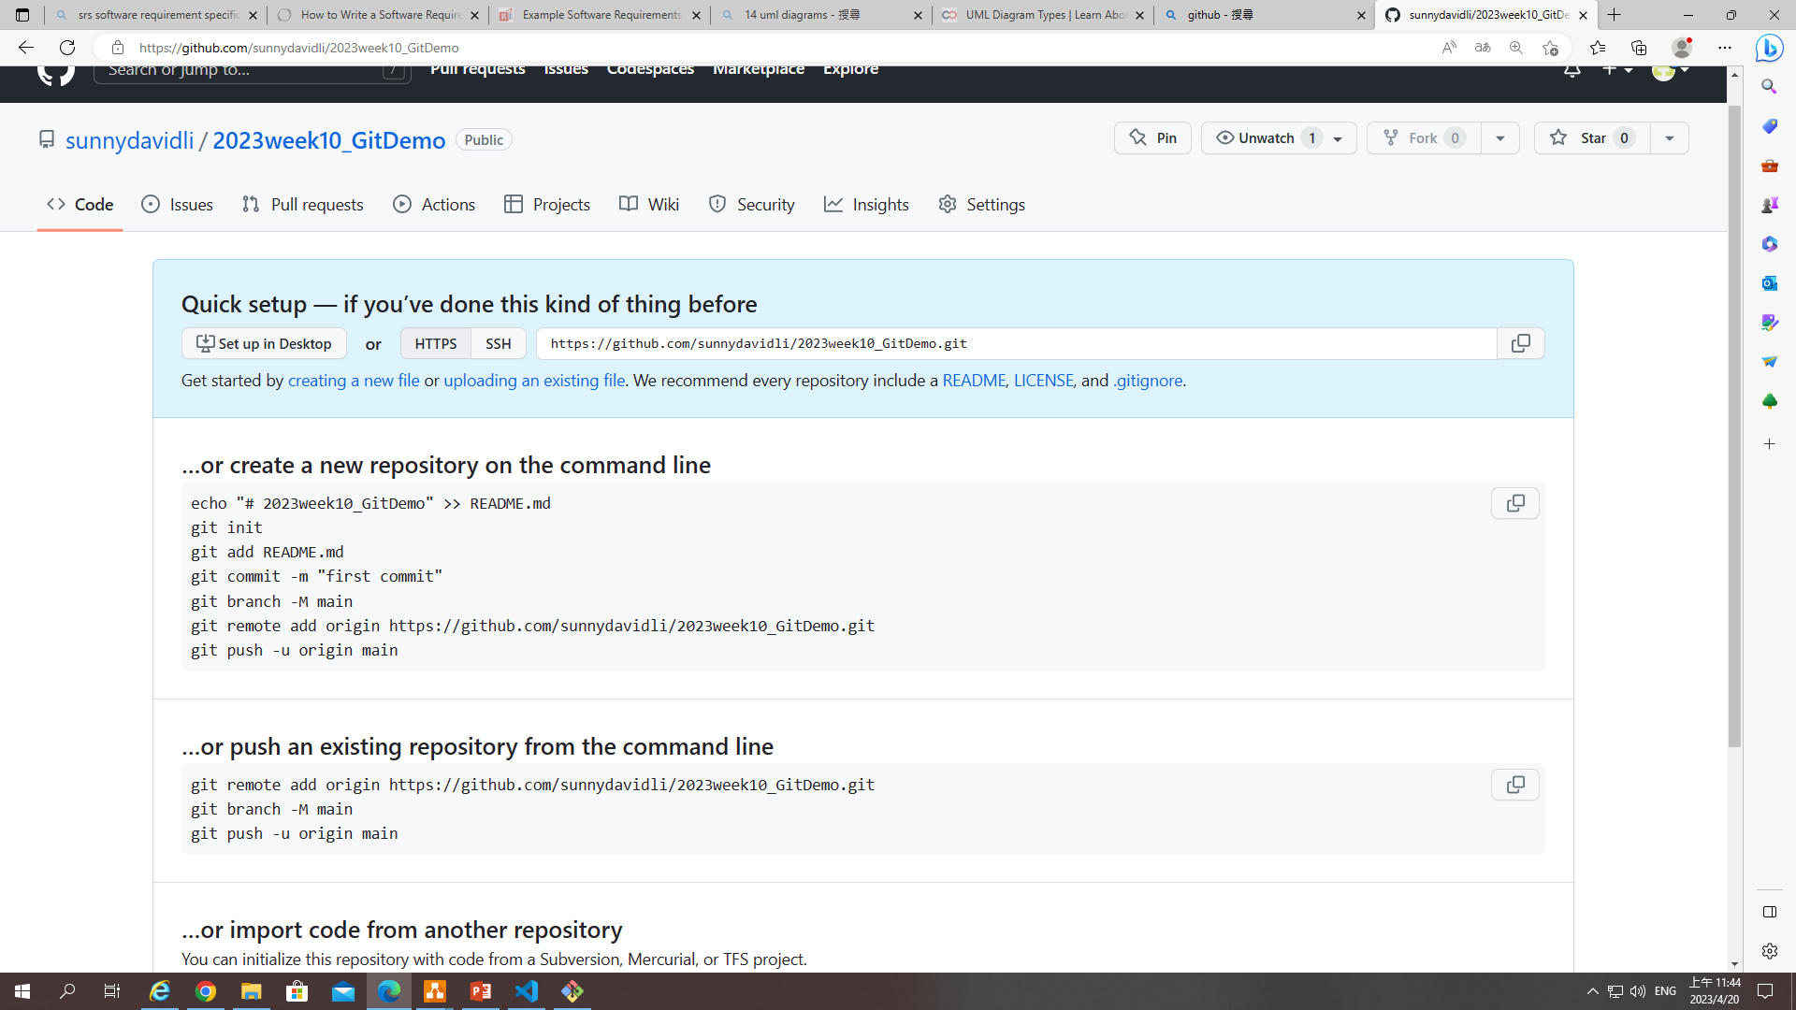

Slide 35
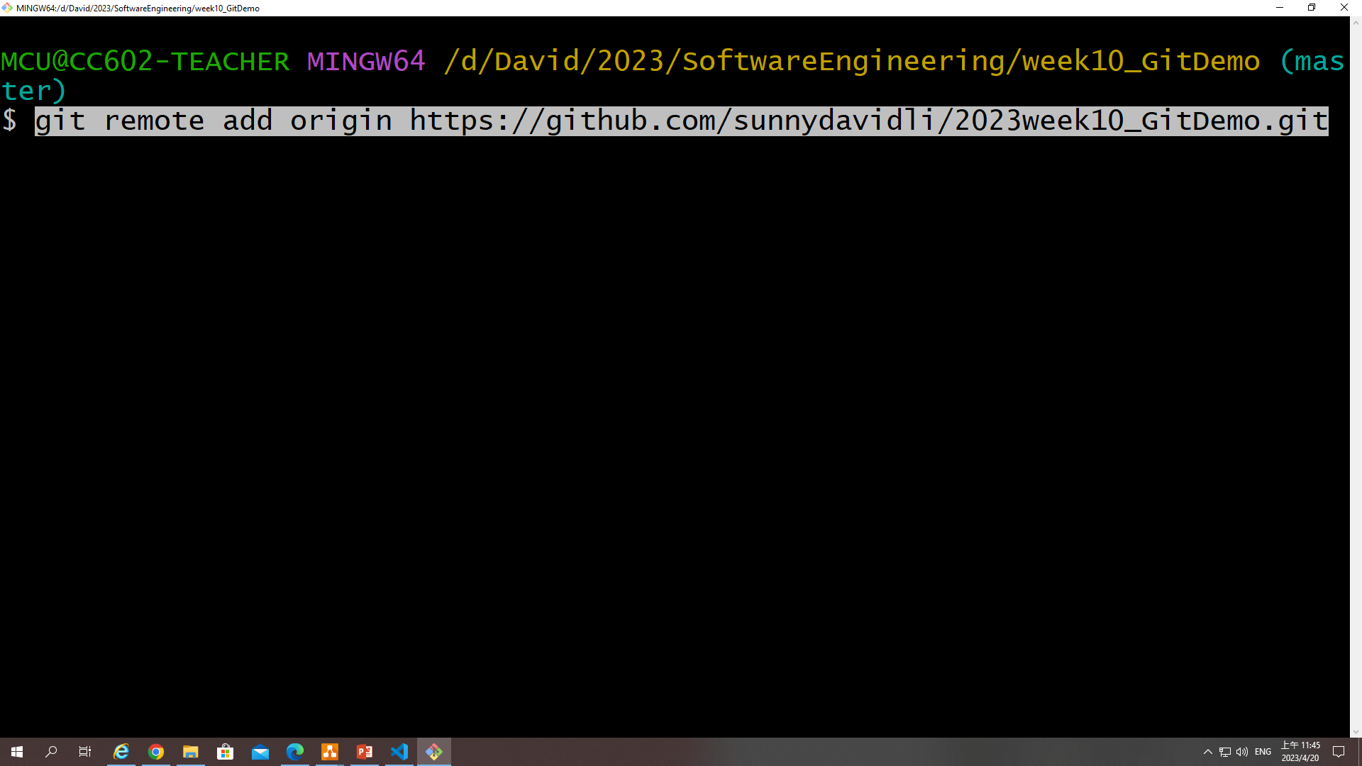
Add your remote repository on your local repository

Slide 36
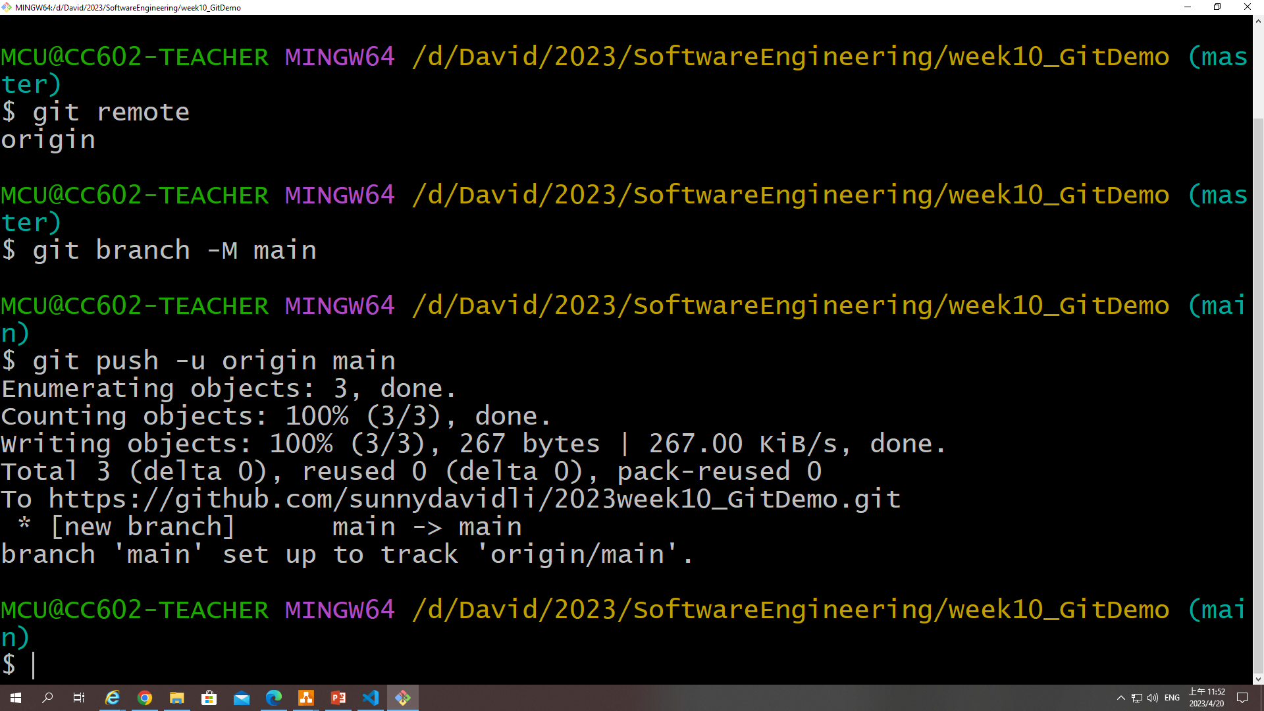

Slide 37
We push any changes on my local repository to the remote repository
…or push an existing repository from the command line
git remote add origin https://github.com/sunnydavidli/2023week10_GitDemo.git
git branch -M main
git push -u origin main

Slide 38
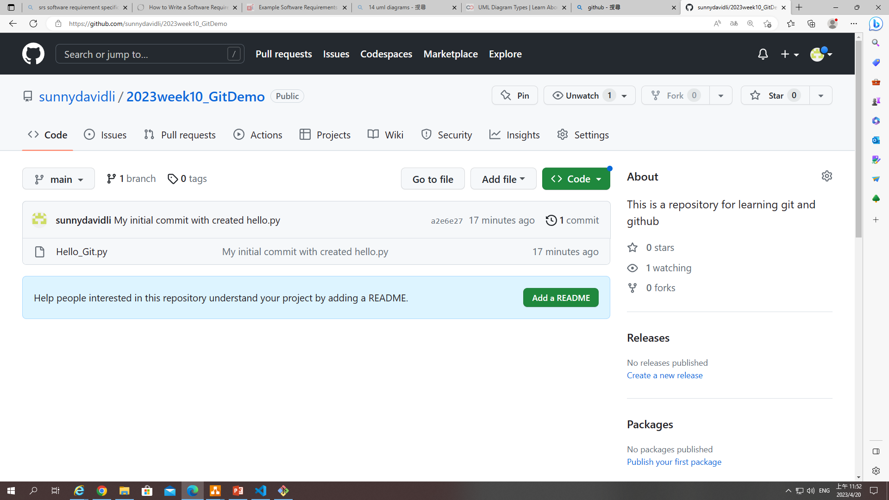

Slide 39
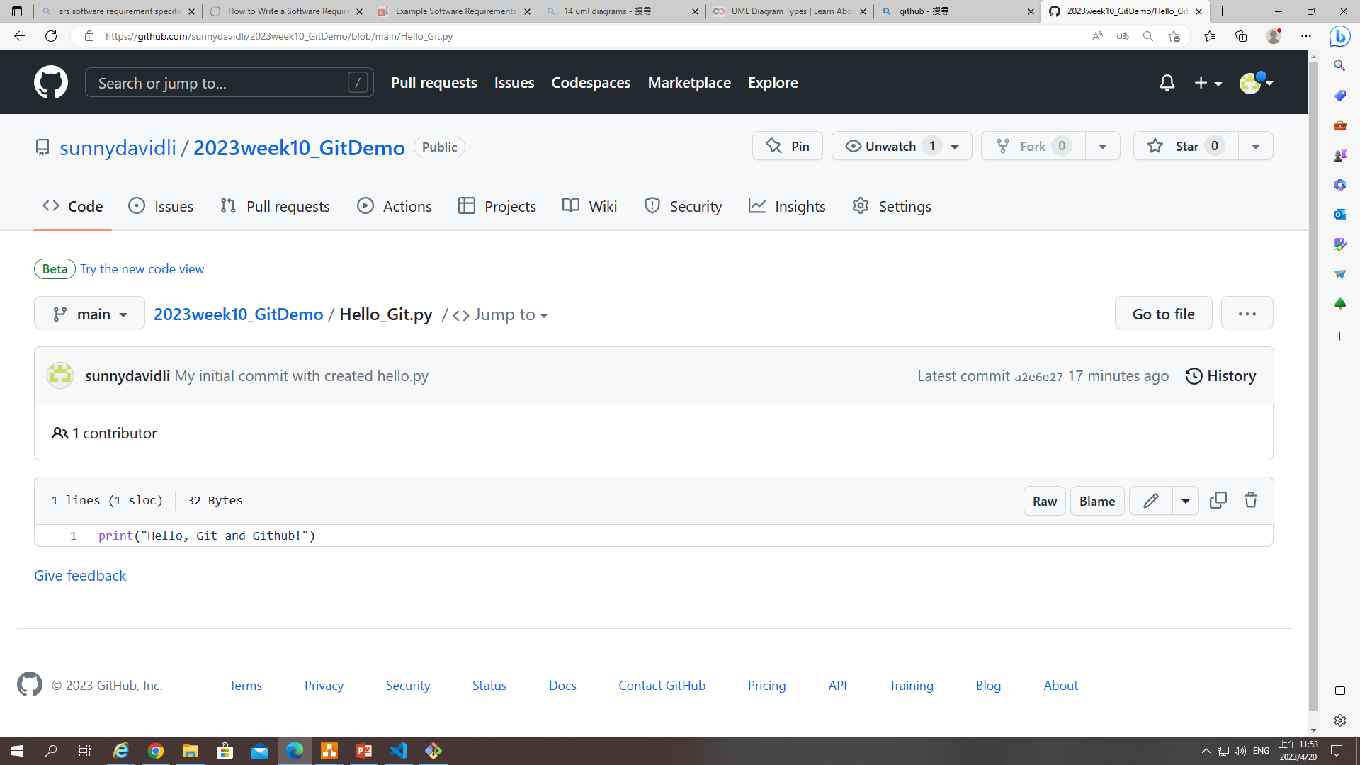

Slide 40
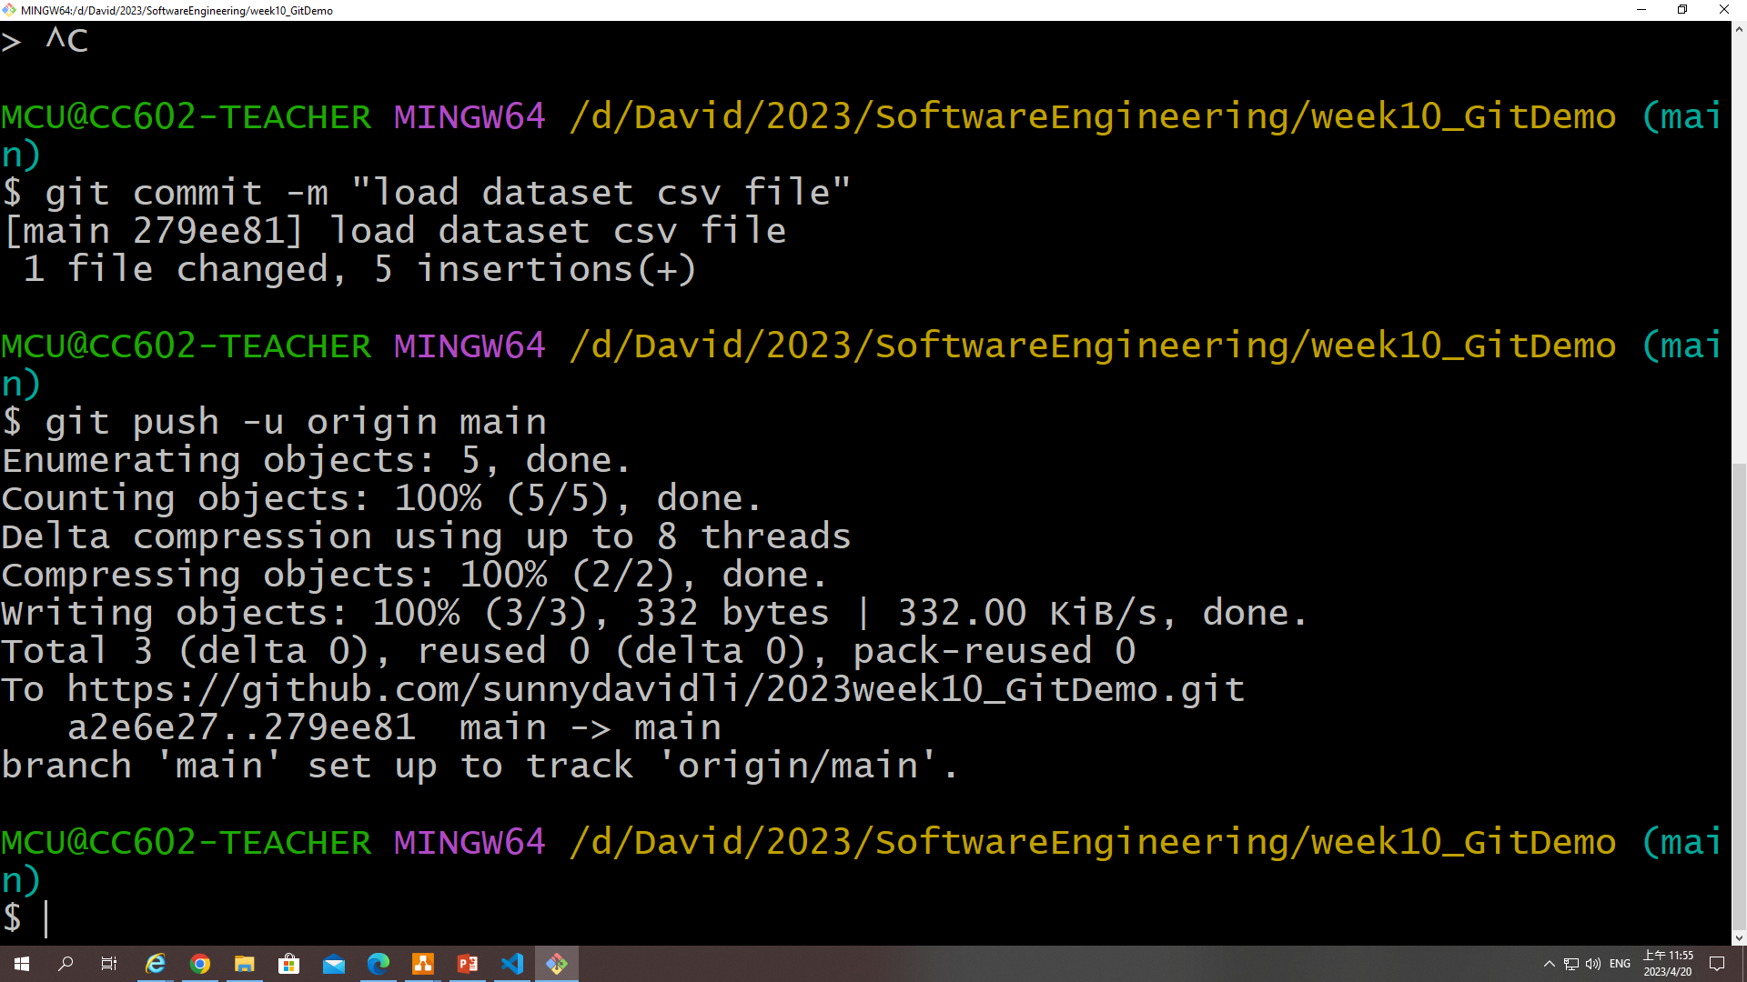

Slide 41
Concepts of Git work flow with Github
Local repository is like your local project folder.
Remote Repository
(github)
Local Repository
HelloGit.py
AnotherModule.py
DataAnalysis.py
Workspace
Local project folder (gitDemo2023):
Python files, text file, figures, logs…
AnotherModule.py
Stage (index)
Temporary save any new changed items
Commit
git add …
Hello.py

